Slide 1
ENGI 301 PocketBeagle Medication Dispenser PCB Proposal
April 11, 2022
Sara Barker

Slide 2
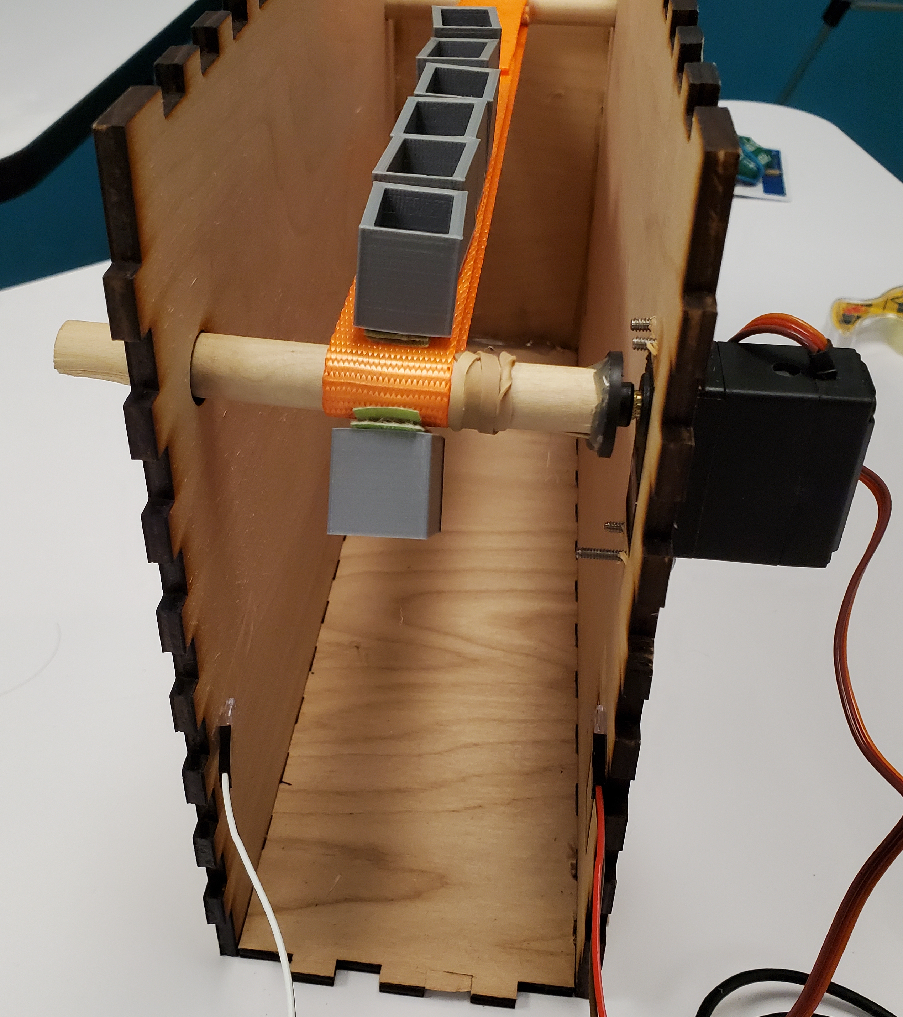
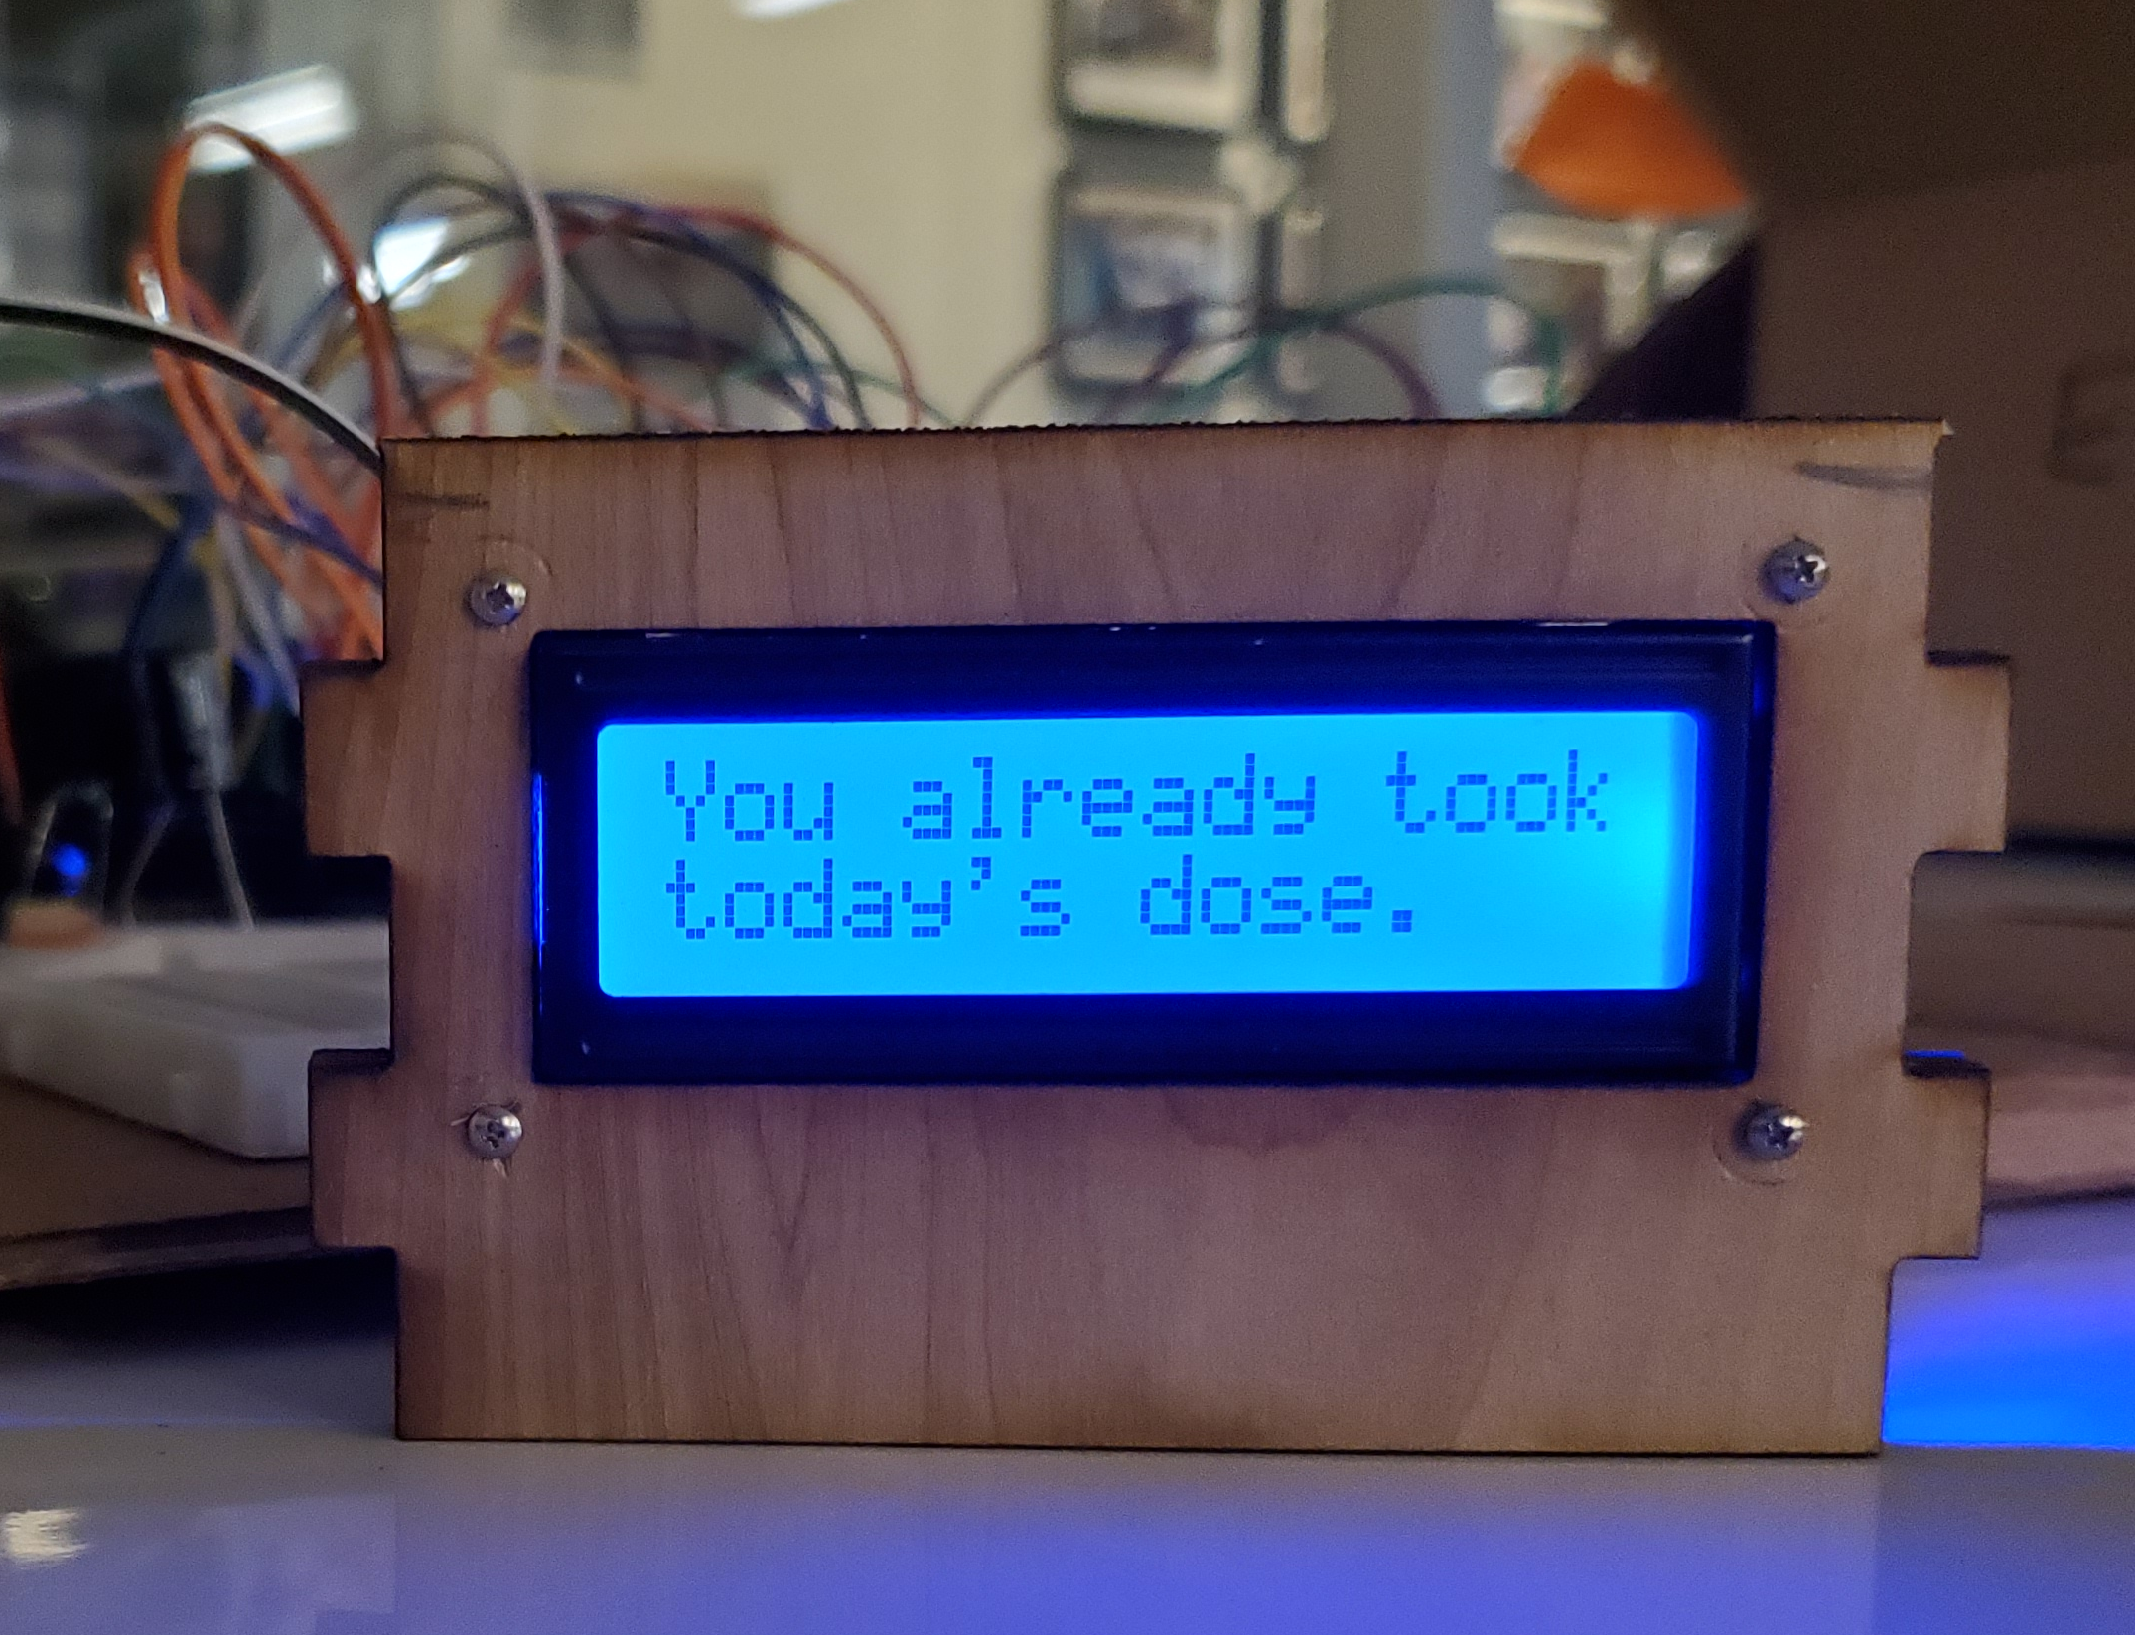
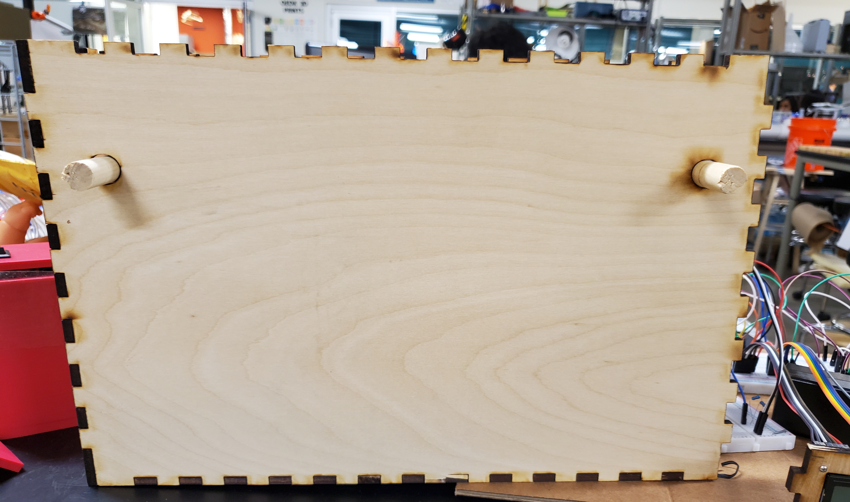
Background Information
Links:
https://www.hackster.io/sarajbarker/pocketbeagle-medication-dispenser-ca1f8f
https://github.com/saraJbarker/ENGI301
Changes Needed:
Make a hole in the back of the box to put the power connection
Add in transistors to allow the color of the LCD to be changed via the PocketBeagle
Attach screen to front of the box
Side view of box
LCD
Front view of box

Slide 3
System Block Diagram
PocketBeagle
Brown
Red
Orange
Servo
GND
5V
5V
GND
IR Emitter 1568-SEN-18772-ND
P1_36
Pin 1, 5
Pin 2
Pin 4
Pin 6
Pin 11
Pin 12
Pin 13
Pin 14
GND
5V
GPIO 87 (P1.02)
GPIO 89 (P1.04)
GPIO 47 (P2.18)
GPIO 64 (P2.20)
GPIO 46 (P2.22)
GPIO 44 (P2.24)
LCD Screen
5V
GND
IR Detector 1568-SEN-19018-ND
Pin 16, 17, 18
Pin 3
Transistors
GND Signal PWR
Potentiometer
GND

Slide 4
3”
.2”
2-pin 100-mil connector for IR emitter
.75”
3-pin 100-mil servo connector
.75”
.1”
.1”
POT
.375”
.2”
.3”
.2”
.375”
.1”
Pocket Beagle
Front of box
2”
10-pin 100-mil LCD connector
Back of box
1”
1.4”
.2”
Micro-USB connector
2-pin 100-mil connector for IR receiver
.1”
.2”
2.2”
.2”

Slide 5
Components Required
Pocket Beagle
3-pin 100-mil servo connector
10-pin 100-mil LCD connector
Potentiometer
2x 2-pin 100-mil connectors (for IR emitter and receiver)
Notes:
- Power connector

